Slide 1
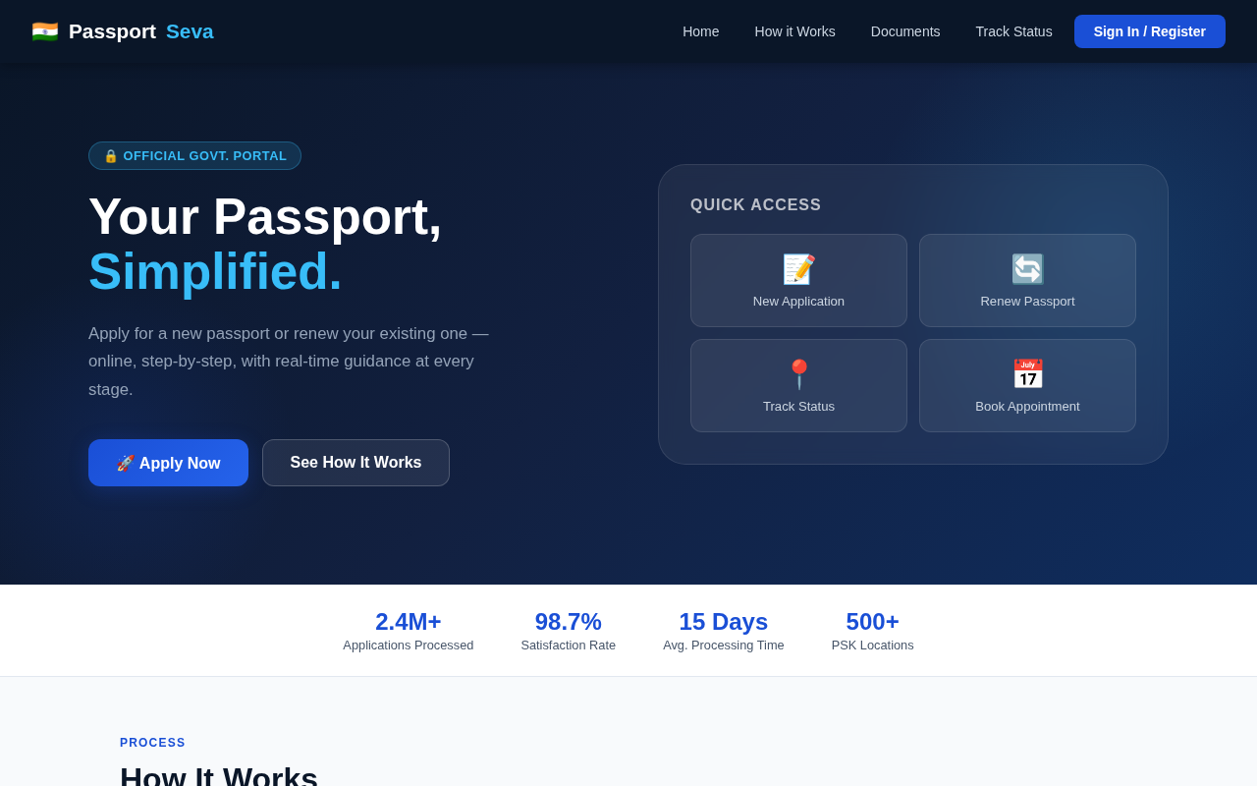
🇮🇳 ANSHUMAT FOUNDATION • 2025
Passport
Seva
India's Passport Application — Redesigned for Real People
7 Screens
Step-by-Step Flow
HTML / CSS / JS
Responsive
PassportSeva • Complete UX Presentation • Anshumat Foundation

Slide 2
THE PROBLEM
Why did India's passport portal need a redesign?
😵
📋
🚫
📅
50+
0%
No
3+
Fields on ONE form
Progress saved
Document Checklist
Pages to book a slot
No steps, no guidance
Refresh = start over
Users don't know what to bring
Date → slots → confirm

Slide 3
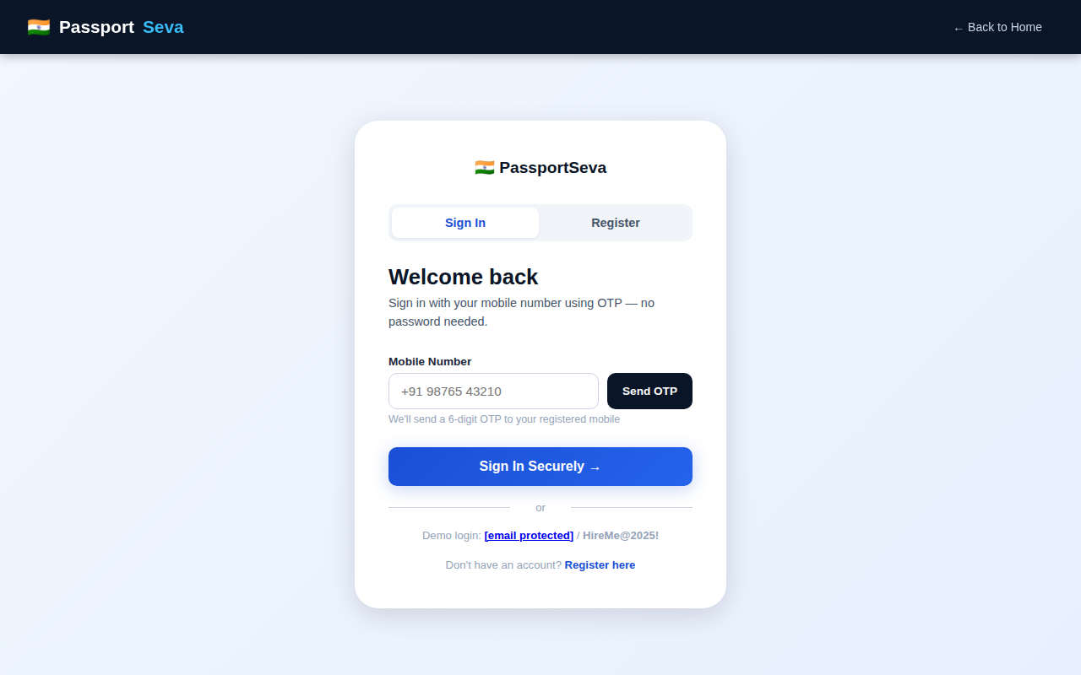
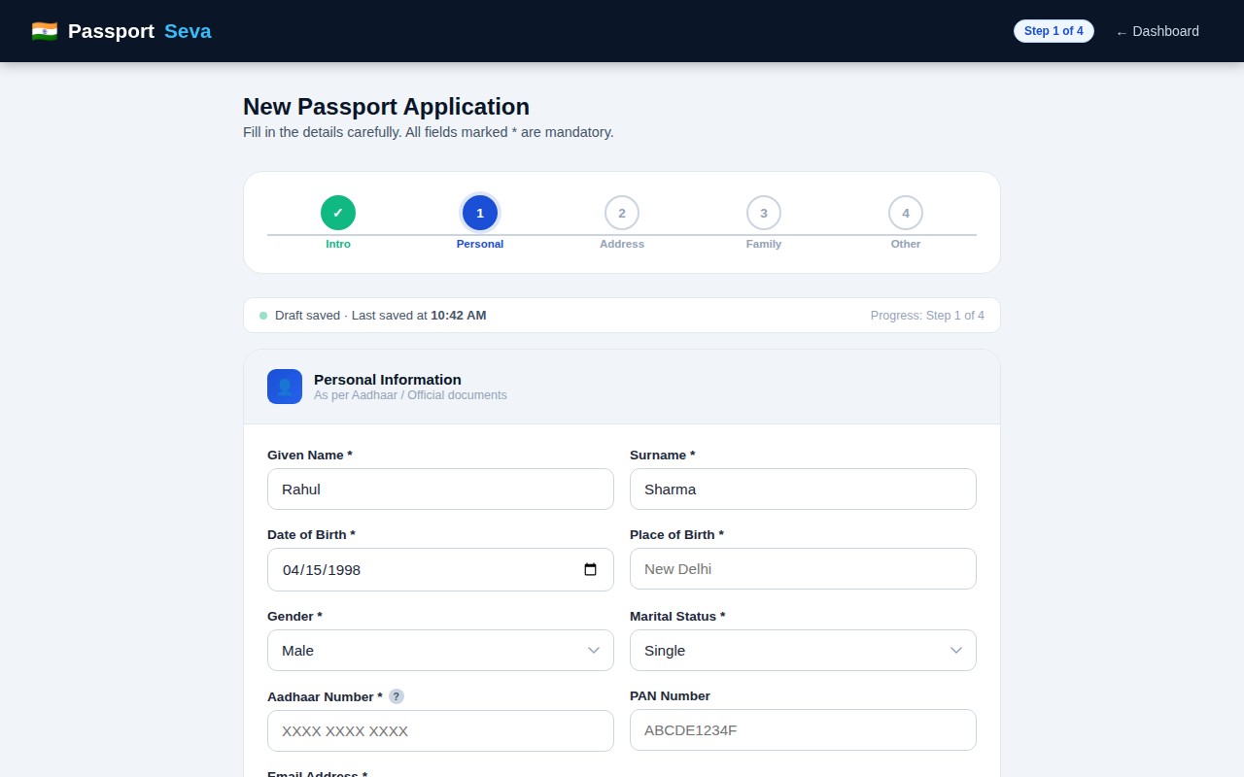
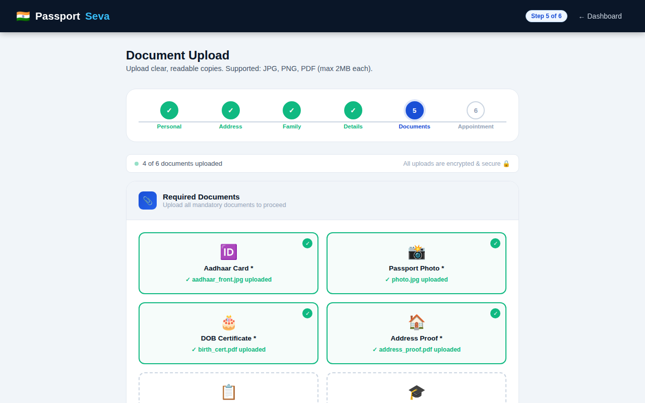
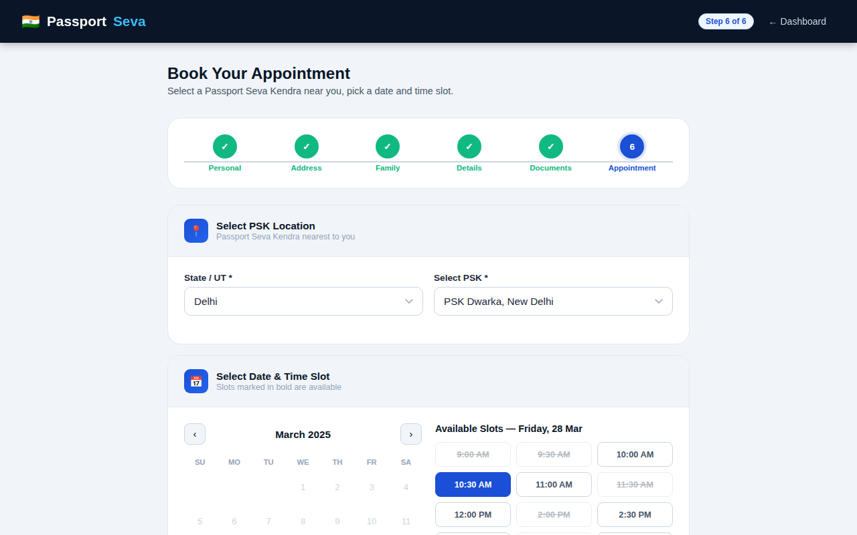
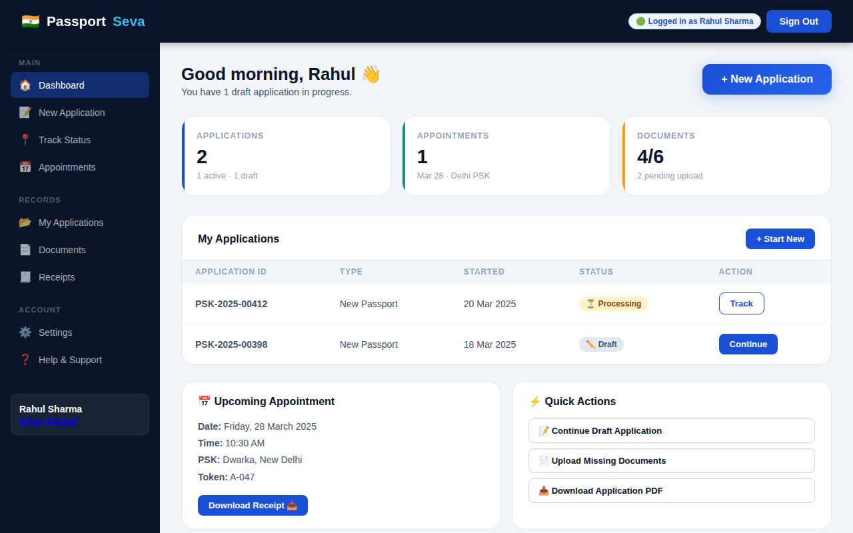
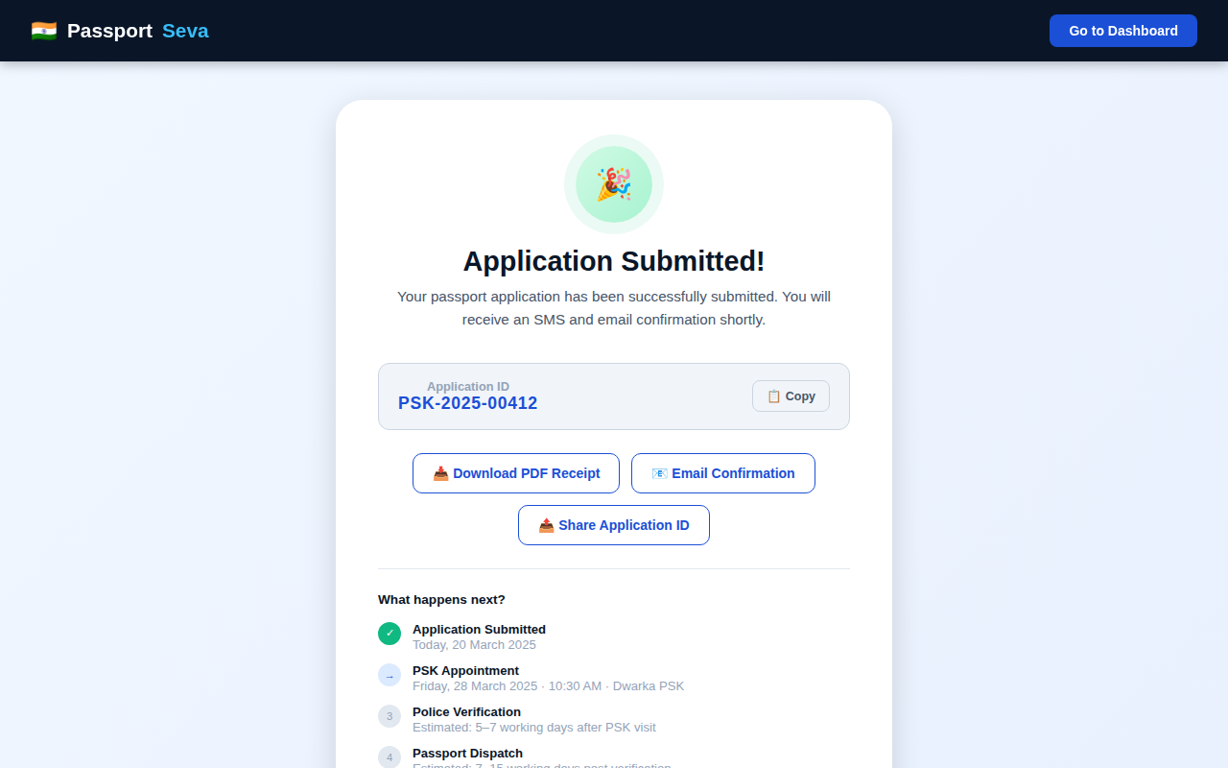
THE SOLUTION — 6 Simple Steps
1
2
3
4
5
6
›
›
›
›
›
Create
Account
Fill
Form
Upload
Docs
Book
Appointment
Visit
PSK
Receive
Passport

Slide 4
USER JOURNEY FLOWCHART
End-to-end passport application flow
START
🌐 Visit
PassportSeva
New
User?
🔑 Sign In
OTP
🏠 Dashboard
📋 New
Application
💾 Auto-Save
Enabled
▶
▶
▶
▶
▶
▶
▶
▼
📝 Register
OTP
🏠 Step 2
Address
👨‍👩‍👧 Step 3
Family
📋 Step 4
App Details
◀
◀
◀
▼
All
Docs?
📎 Upload
Documents
📅 Book
Appointment
✅ Submit
Application
▶
▶
▶
No
▼
END
Re-upload
🎉 Confirmation
+ Application ID
▶
Action
Decision
Auto Feature
Success

Slide 5
01
Homepage
Landing Page
🔒
Trust Badge
Govt portal badge + stats strip builds instant credibility
⚡
Quick Access
4 shortcuts for returning users — no scrolling needed
📊
Social Proof
2.4M+ apps, 98.7% satisfaction shown above the fold
🎯
Clear CTA
Apply Now stands out with gradient + shadow button

Slide 6
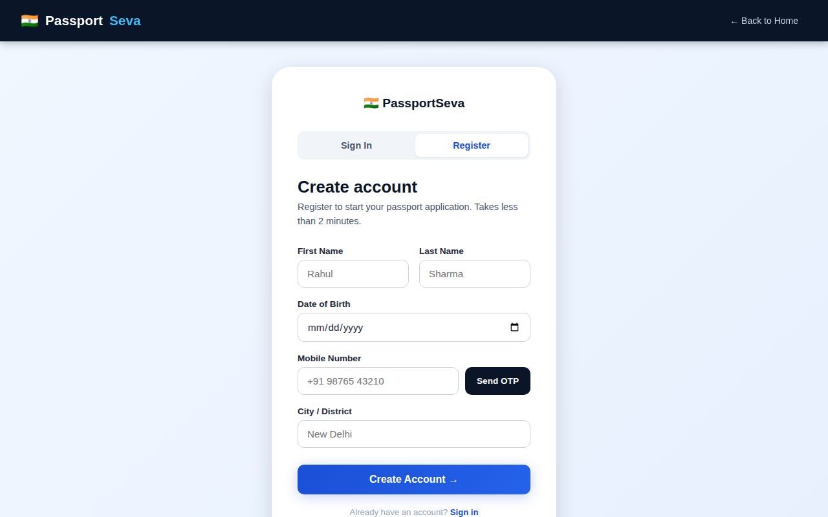
02 Sign In / Register
OTP-only auth — no passwords
📱
OTP
only
30s
countdown
Zero
password
Works
on all
phones
Sign In
Register

Slide 7
03 User Dashboard
📊
Status Cards
3 metric cards: apps, appointments, documents
📋
Apps Table
Status badges: Draft, Processing, Submitted, Ready
📅
Appointment
Date, time, PSK, token — always visible
⚡
Quick Actions
Continue draft, upload docs, download PDF

Slide 8
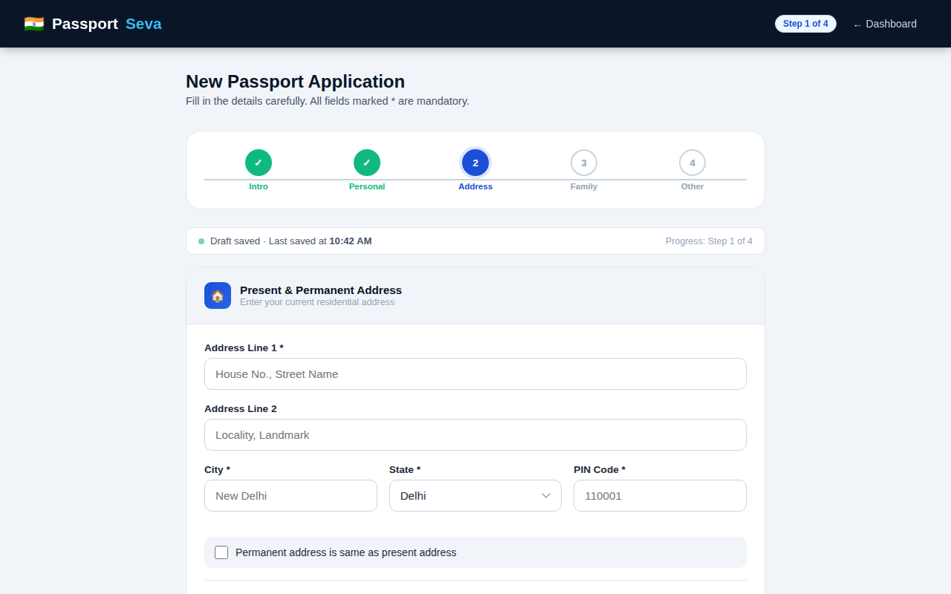
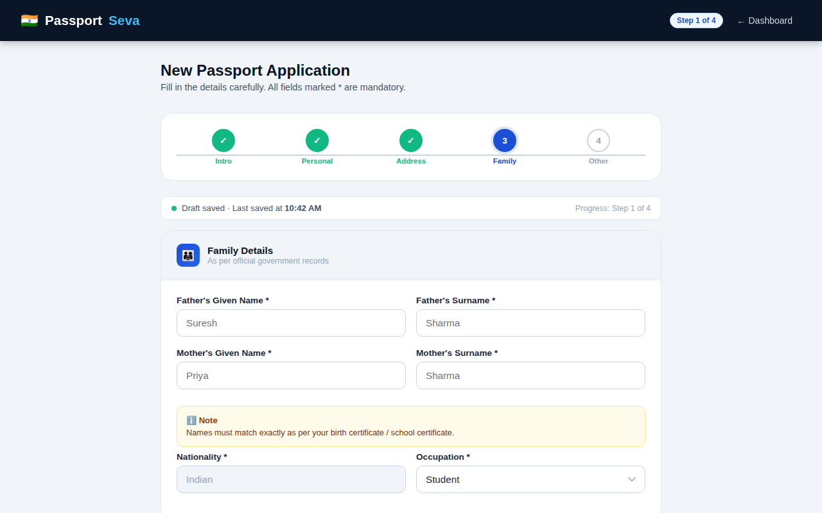
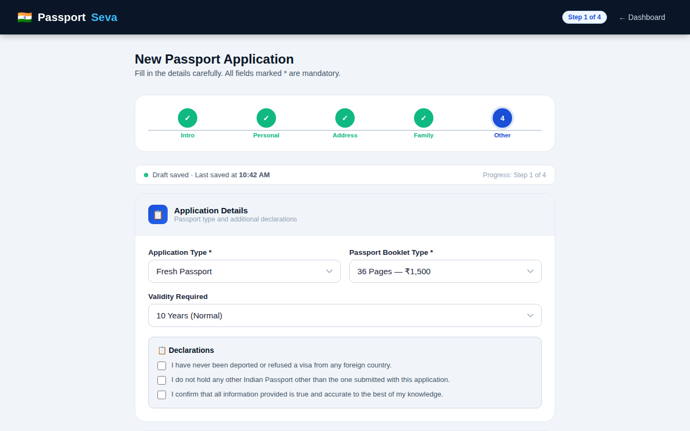
04 Application Form — 4-Step Wizard
Step 1 · Personal Info
💾 Auto-saves every 45 sec
Step 2 · Address
Step 3 · Family
Step 4 · App Details

Slide 9
05 + 06 Document Upload & Appointment Booking
📎 Card grid — not plain file inputs
📅 Calendar + slots on ONE screen
✅ Click to upload → green border
🔴 Full slots = strikethrough

Slide 10
07 Confirmation Screen
What happens after submission
✓
Application Submitted
Day 0
Day 0
2
PSK Appointment Visit
Day 8
Day 8
3
Police Verification
Day 13–15
Day 13–15
4
Passport Dispatched
Day 22–25
Day 22–25
5
Doorstep Delivery
Day 28–30
Day 28–30
📥 PDF Receipt 📧 Email Confirm 📤 Share ID

Slide 11
Key UX Features — Before vs After
Feature
❌ BEFORE
✅ AFTER
📝 Form
1 long form with 50+ fields
4-step wizard with progress bar
💾 Autosave
No save — refresh loses everything
Saves every 45 sec + on each step
📎 Uploads
Plain file inputs, no guidance
Visual cards with status + guidelines
📅 Booking
3 separate pages to pick a slot
Calendar + slots on ONE screen
✅ Confirmation
Basic 'submitted' message only
ID copy + PDF + email + timeline

Slide 12
Tech Stack & File Architecture
🏗️
🎨
⚙️
index.html
styles.css
script.js
45 KB
37 KB
15 KB
7 screen panels
CSS variables
Screen routing
Semantic HTML
Component classes
Form wizard
ARIA labels
Animations
Autosave system
Navigation links
Media queries
Toast manager
⚡ Zero frameworks • Total < 100 KB • Works with any backend

Slide 13
🇮🇳
PassportSeva
Designed for every Indian citizen — not just the tech-savvy ones.
7
4
45s
13
Screens
Form Steps
Autosave
Screenshots
Demo Login → hire-me@anshumat.org / HireMe@2025!
Built with HTML5 • CSS3 • Vanilla JS | Anshumat Foundation • 2025

